Slide 1
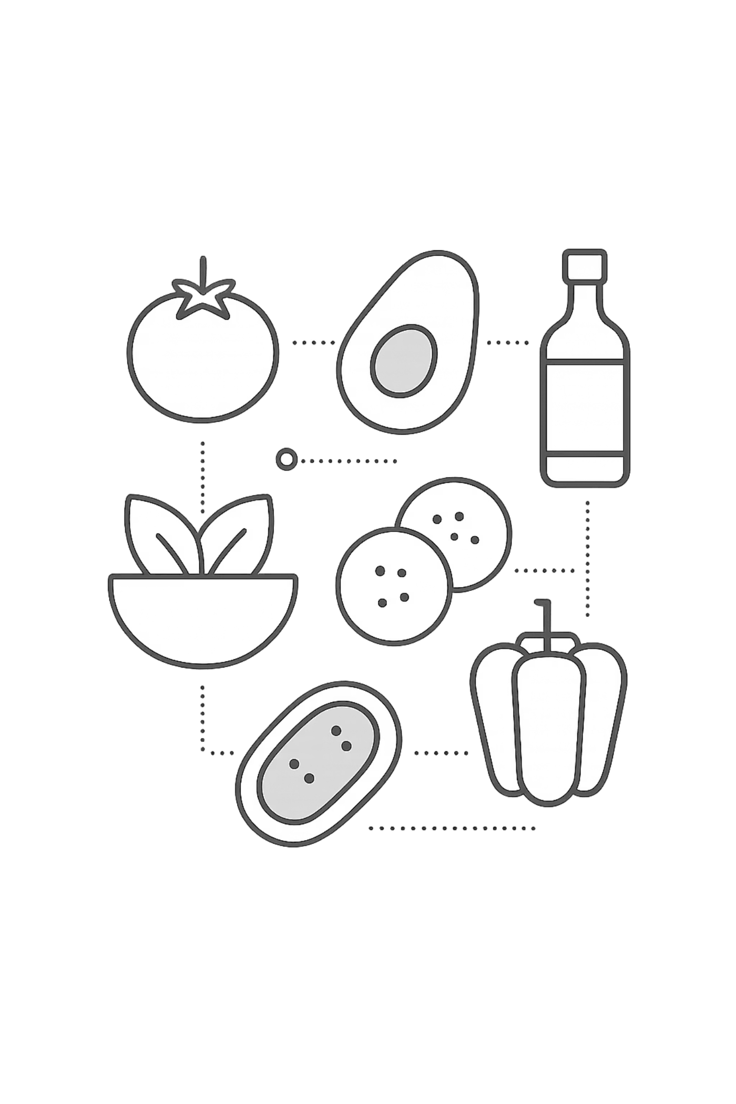
NutriAI: AI-Assisted Smart Diet Planner
A collaborative project exploring AI-driven personalized nutrition solutions.
Presented By: 2303A51064(N.Rohan)
2303A51071(P.LAHARI)
2303A51053(G.VARSHITHA REDDY)
2303A51058(K.UJWAL REDDY)
Course: B.Tech – Computer Science
College: SR UNIVERSITY
Academic Year: 2025–2026

Slide 2
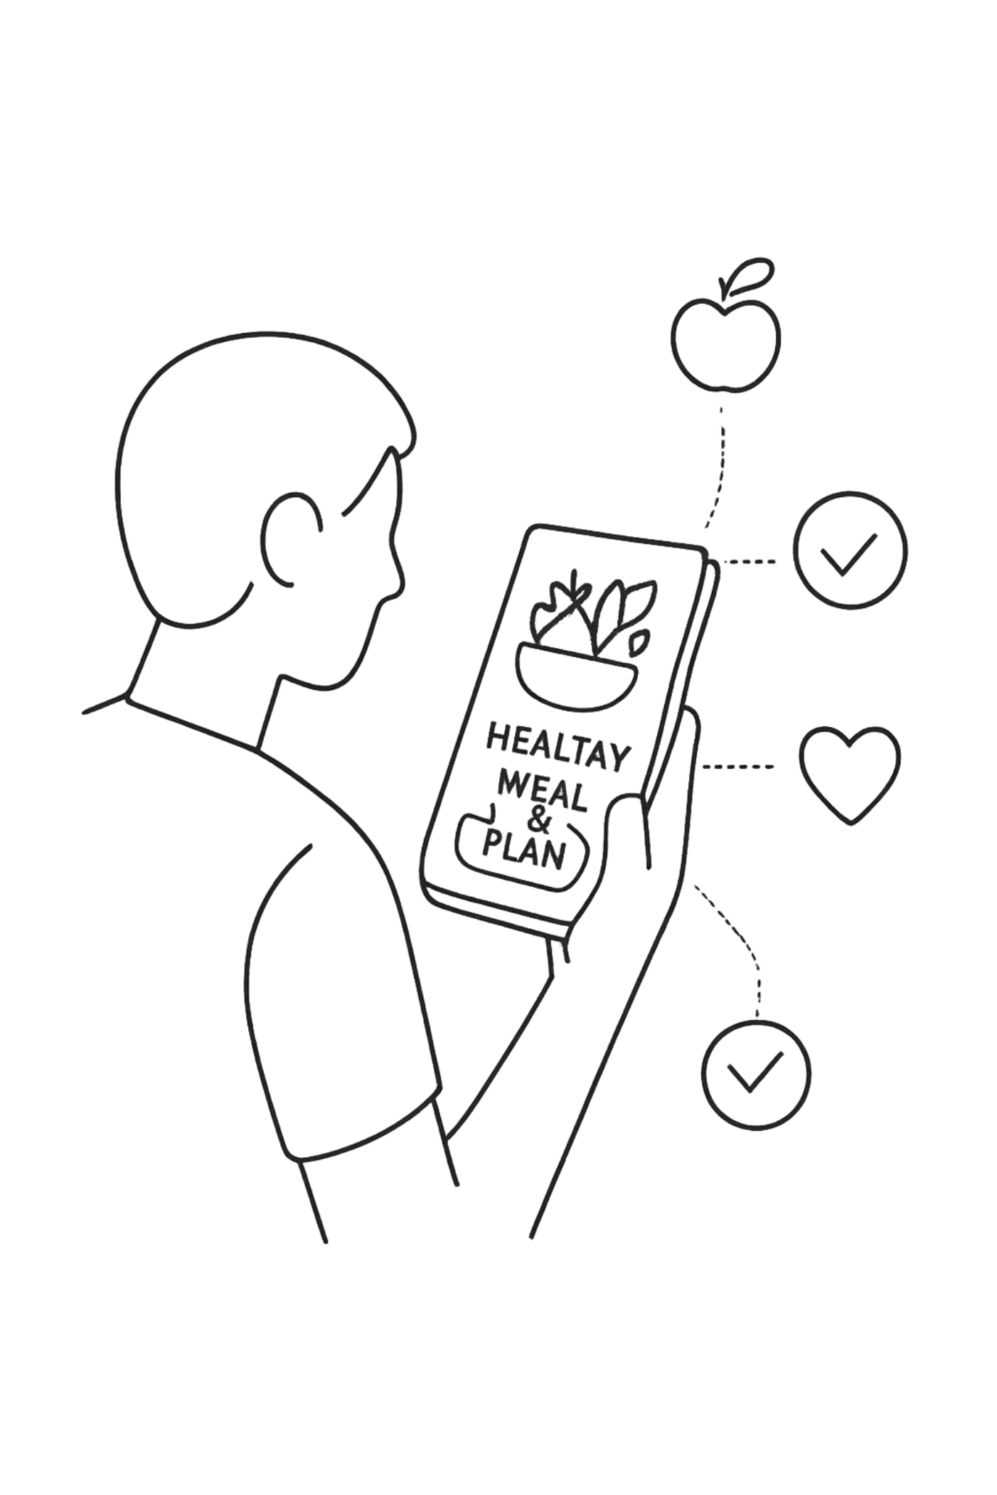
Project Overview: NutriAI Smart Diet Planner
What is NutriAI?
The Problem
A smart web application for personalized diet planning
Generates customized 7-day diet plans
Uses BMI and TDEE for accurate recommendations
Supports vegetarian and non-vegetarian preferences
Many people struggle to maintain a balanced diet
Lack of awareness about proper nutrition and fitness
Difficulty in creating structured meal plans
Current Tools Are Limited
Existing apps lack proper customization
Limited integration of diet, BMI, and fitness together
NutriAI solves this using AI-assisted development

Slide 3
NutriAI's Objectives: NutriAI Smart Diet Planner
Personalized Diet Planning
Health & Fitness Awareness
Generate customized 7-day diet plans
Adapt based on user goals and preferences
Support vegetarian and non-vegetarian options
Promote healthy eating habits
Encourage balanced nutrition and lifestyle
Provide simple and practical health guidance
Automation & Accuracy
AI-Assisted Development
Automatically calculate BMI and TDEE
Reduce manual effort in diet planning
Provide accurate and structured recommendations
Use AI tools for code generation
Improve development speed and efficiency
Enhance overall application functionality

Slide 4

Key Stakeholders: A Collaborative Ecosystem
Health-Conscious Users
Fitness Enthusiasts
Individuals seeking personalized diet plans
Users aiming to improve lifestyle and nutrition
People looking for simple health guidance
Users focused on weight loss and fitness goals
Require structured diet and exercise plans
Need goal-based recommendations
Students & Developers
Academic Evaluators
Learners exploring web development projects
Interested in AI-assisted coding techniques
Gain practical project experience
Faculty assessing project design and implementation
Evaluate innovation and practical application
Focus on clarity, structure, and usability

Slide 5
Tech Stack: Foundation for Intelligence and Speed
Frontend Architecture
1
HTML for structure, CSS for styling and responsive design, JavaScript for interactivity and dynamic content generation.
Data Handling
2
localStorage used for storing user inputs and maintaining data persistence within the browser without external databases.
AI Integration
3
ChatGPT and Claude used for code generation, debugging, and improving UI/UX, enabling faster development.
Development Tools
4
GitHub for version control, VS Code as development environment, and browser DevTools for testing and debugging.
Application Design
5
Clean card-based UI with responsive layout, green-themed design, and user-friendly interface for better experience.

Slide 6
AI Prompts & Code Generation: Part 1
Application Development Using AI
NutriAI uses structured AI prompts to generate core functionalities including form design, calculations, and diet planning features.
Build a complete AI Diet Planner web application with user input, BMI, diet plan, and clean UI.
Create a responsive form with validation for age, weight, height, goal, and food preference.
Full application structure generation using AI-assisted coding
User input system with proper validation and alignment
Generate BMI calculator using JavaScript and display result with category.
Generate a structured 7-day diet plan with meals for each day.
Automatic BMI calculation with categorized output
Personalized meal planning with clear daily structure

Slide 7
AI Prompts & Code Generation: Part 2
Complete Application Workflow
User Input Processing
AI helps design input forms to collect user data such as age, weight, height, goal, and food preference.
BMI & Data Analysis
JavaScript logic generated using AI calculates BMI and categorizes user health status.
Personalized Planning
AI-generated code creates customized 7-day diet plans based on user goals and preferences.
Exercise Recommendation
AI assists in suggesting exercises with type and duration based on fitness goals.
Food Restrictions & Tips
Generates foods to avoid and health tips for better lifestyle management.
Output & Download Feature
AI helps implement structured output display and download option for the diet plan.

Slide 8
Frontend View: Application Interface
User Input Section
BMI Result Card
Clean form with fields for age, weight, height, goal, and food preference
Displays calculated BMI value along with health category
Diet Plan Section
Exercise Recommendation
Shows structured 7-day diet plan with meals for each day
Provides goal-based exercises with duration and type
Foods to Avoid & Tips
Download Feature
Displays restricted foods and simple health tips
Allows users to download the generated diet plan as a text file

Slide 9
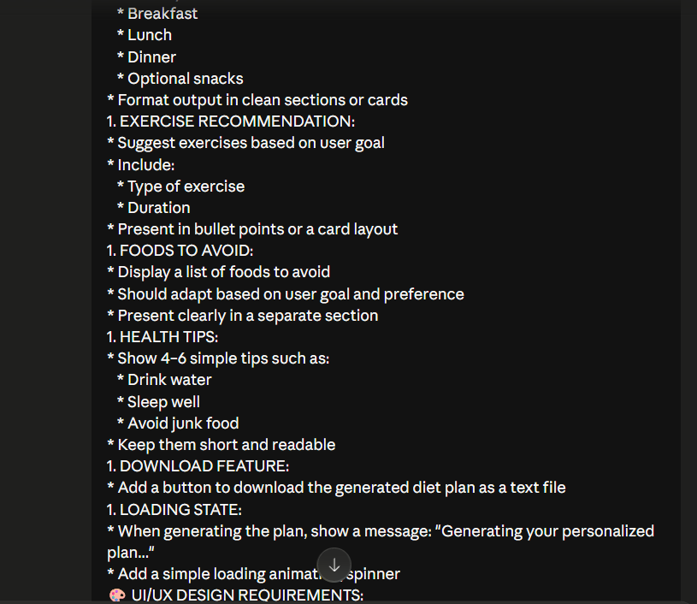
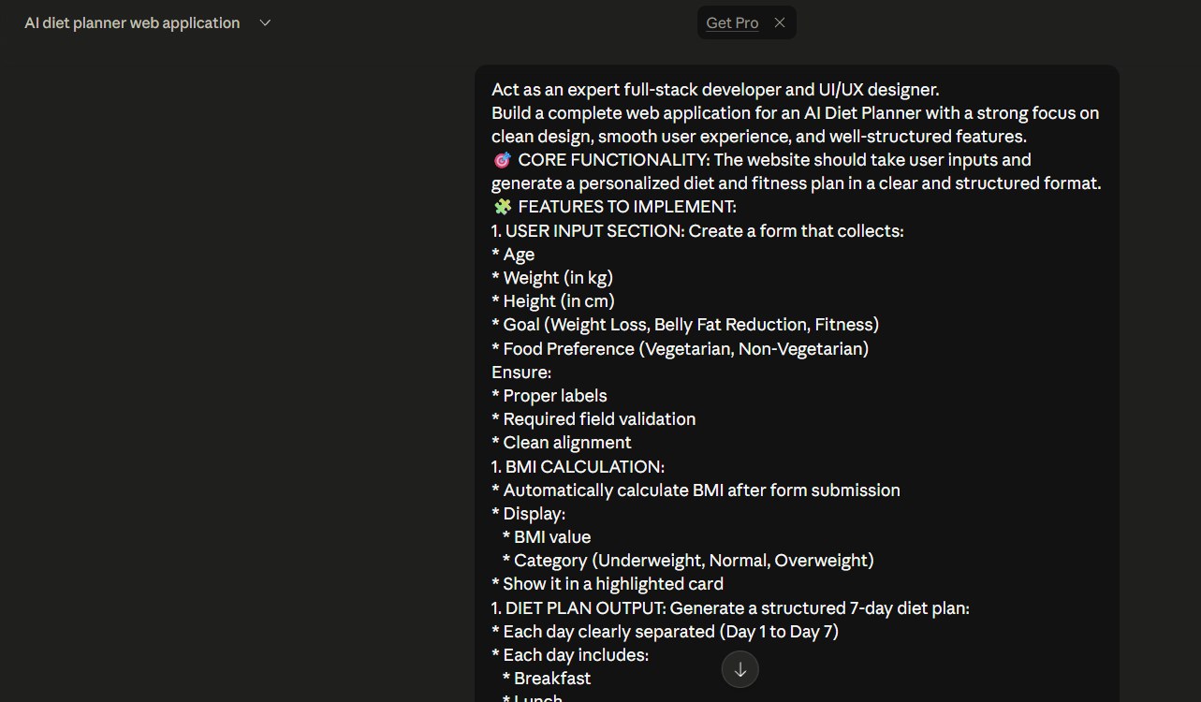
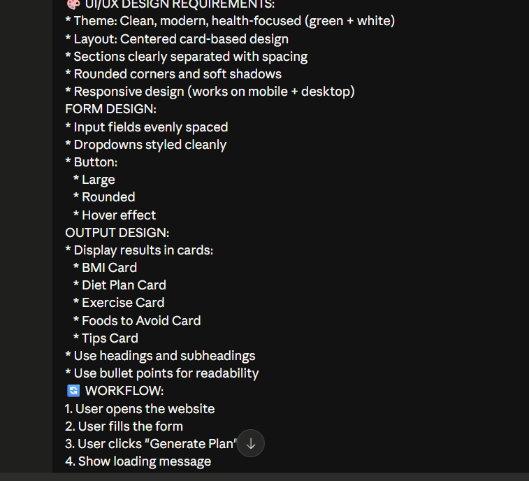
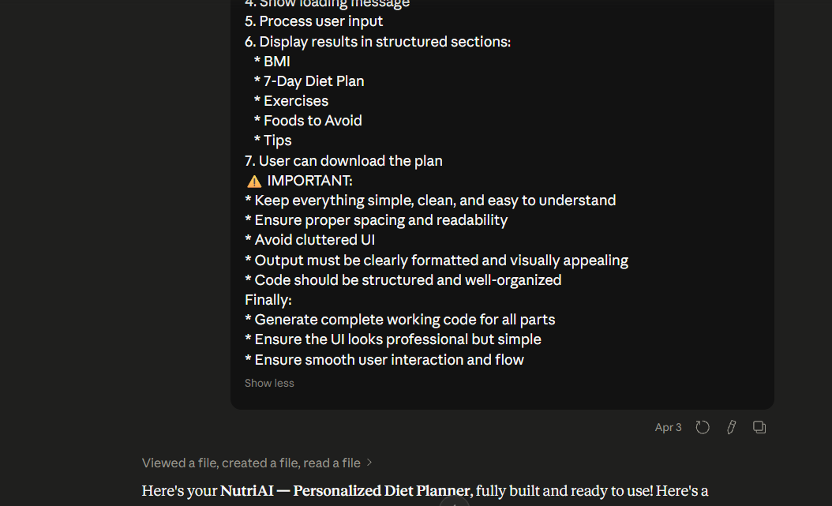
Proof of Prompts Generating Codes
LIVE LINK: https://rohannamuthabaji.github.io/NutriAi/

Slide 10
References & Resources
AI Tools
Web Documentation
ChatGPT and Claude used for code generation, debugging, and UI improvements
MDN Web Docs for HTML, CSS, and JavaScript concepts
Development Platform
Technical Concepts
GitHub for version control and project management
Mifflin-St Jeor formula for TDEE calculation and BMI standards
Design References
Additional Resources
UI/UX best practices for responsive and clean interface design
Online tutorials and web development learning platforms

Slide 11
THANK YOU

